Slide 1

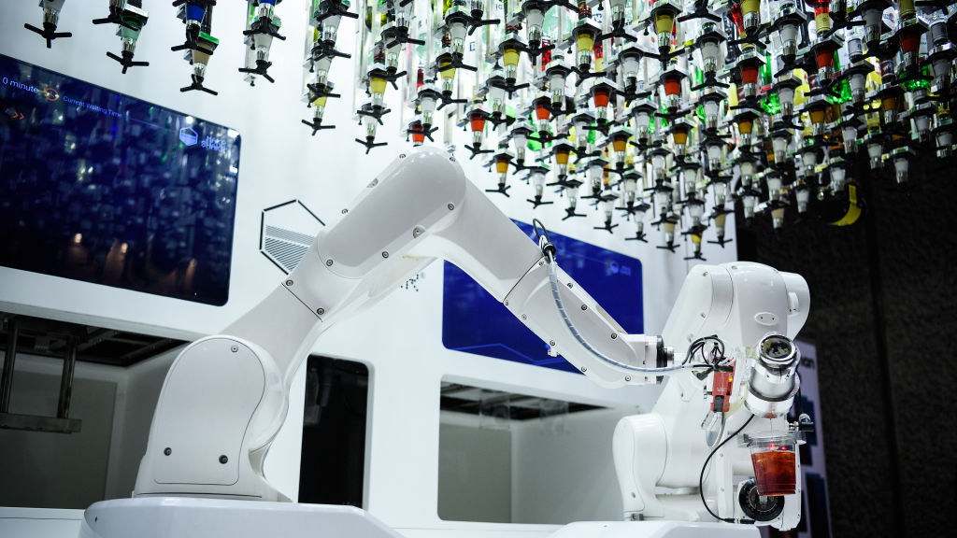
UR10e Robot Cocktailer Maker
Sebastian Schroder
Jiahui Huang
Leroy Heta

Slide 2
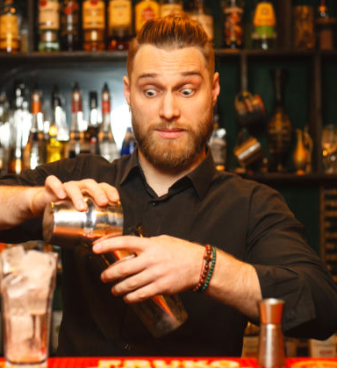
Aren’t you sick of Bartenders not making your drink right everytime?

Slide 3
Look no Further than the amazing robot cocktail maker

Slide 4
Robot Modelling

Slide 5



Implementation
Installed alongside tablet which would allow customers to choose their desired drink.
Bar owners would have access to full controls of the arm and allow them to customise drinks and recipies.

Slide 6
GUI in Operation

Slide 7
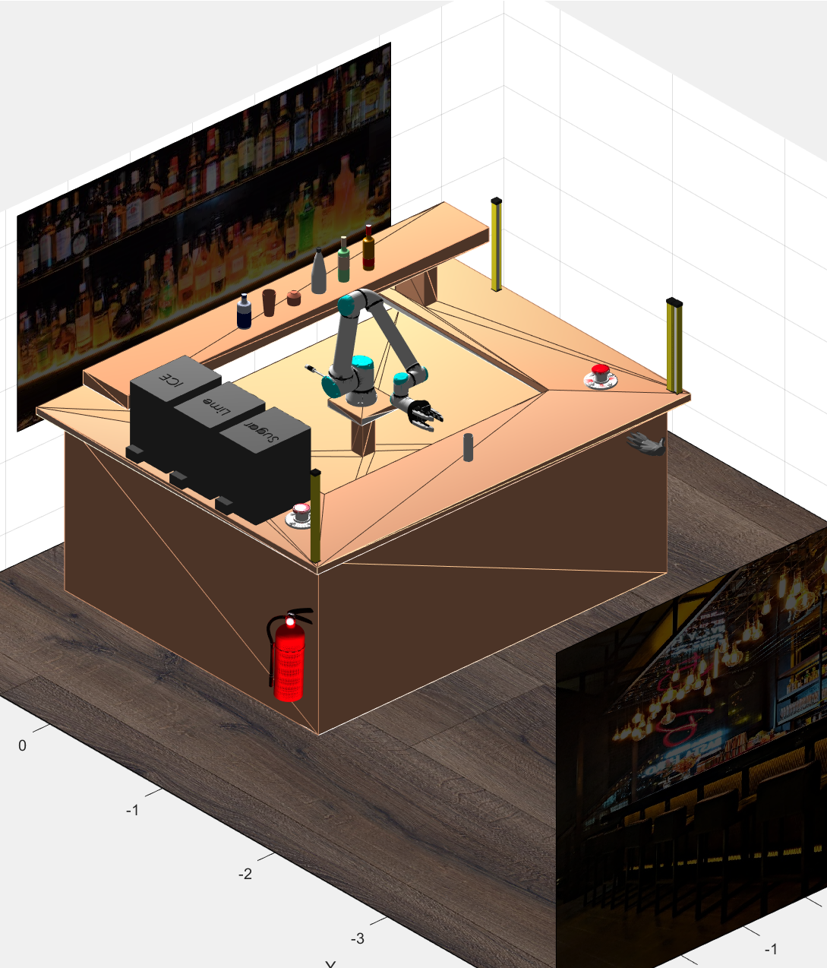
Planning and Safety
Fire hazards secured w/ fire extinguisher
Functional e-stop buttons located all all sides of the arm.
Functional light curtains placed on bar
Bar designed to exceed working radius of arm
Object Avoidance Implemented

Slide 8
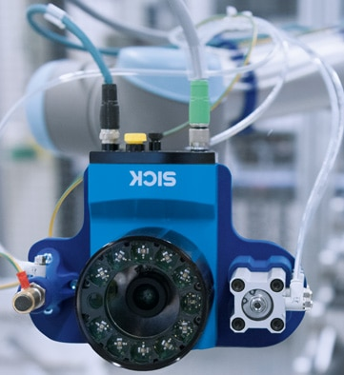

Robotic Sensing:
Future Improvements:
Robotics sensing: Ideas for applicable sensors that would (1) give the robot more capability; and (2) Improve the system’s safety
A visual sensor (illumination incorporated) to determine location of drinks without reliance on hardcoded positions.
Collision detection improved to utilise the visual sensor.
Reactance on unexpectant joint torques to catch collisions and stop.
Illumination to aid sensor accuracy in dimly lit bar environment
Sensors to determine bottle flow rate to ensure correct amount of fluid poured.

Slide 9
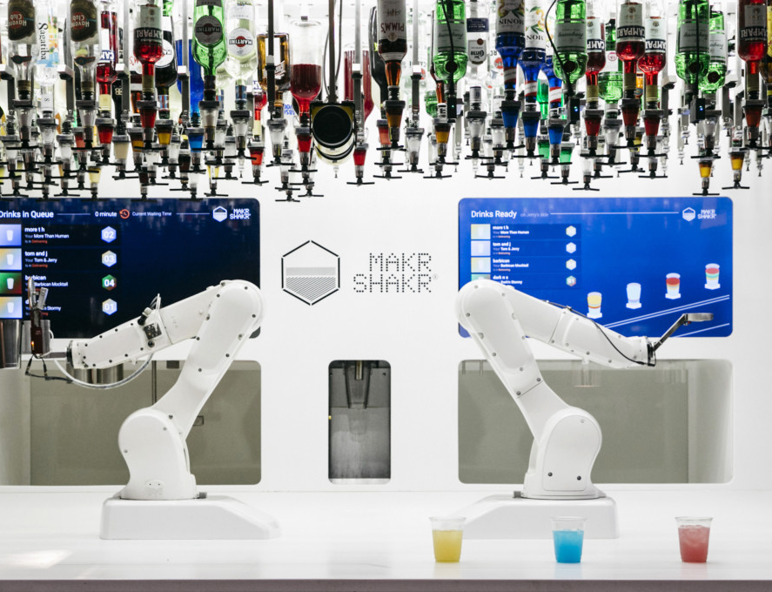
Future Predictions For Robotics
Evidence-based future predictions for robotics in the given scenario
There are similar current implementations that don’t utilise a complex gripper and thus are reliant on standardised bottles and huge setups, our design can be installed in a current bar and run from day 1
We expect in the future that while robotic bartenders won’t become mainstream, they may pop up from bar to bar. With hopefully market growing as efficiency, effectiveness and profitability grow.

